Slide 1
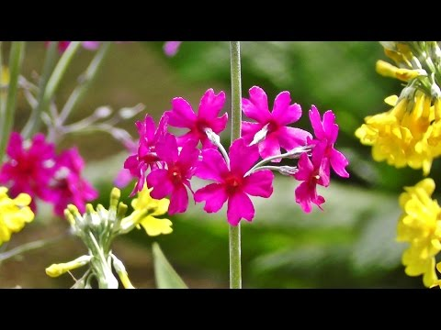
Notes:
Anticipatory set...

Slide 2
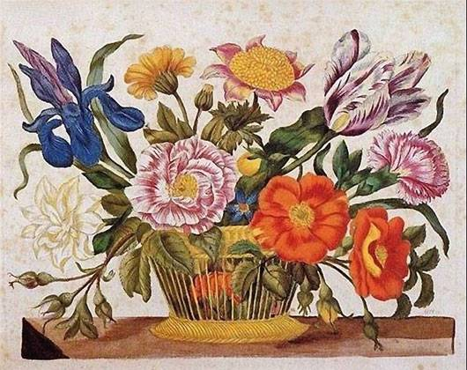
The People Behind Pansies
The Fabulous Flower Fascination Foundation presents:
Women’s role in the history of floral art
17th Century- The Dutch:
IN EUROPE---AT THIS TIME……
Artistic subject matter was formed by societal pressure for women to only portray what was seen as feminine
& if they didn’t- it would be seen as unladylike and scandalous.
So- women artists used what card they were dealt and empowered themselves
Many male artists did not paint flowers because it was seen as unmanly- it was meant for the delicate hand of a female to create such delicate work
Notes:
Here- introducing the WHERE & TIME period---and what was going on during this time period...a light discussion. RELATABLE & age appropriate...relatable---being excluded

Slide 3
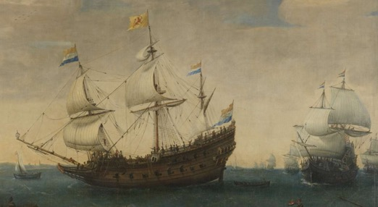
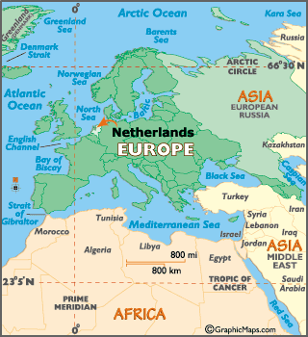
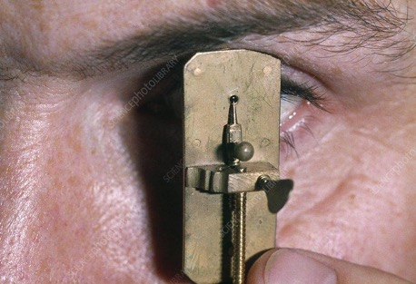
Holland -----------where science met art
The Dutch were Europe’s leading horticulturists at this time.
Increased interest in botanical and zoological knowledge due to :
Exploration- explorers were bringing home species from other lands
The invention of the microscope was in Holland
Notes:
More emphasis on WHERE--to give more perspective….on technology abilities gave reasons for such illustrations to even happen other than flowers are pretty
Antonie van Leeuwenhoek- single lense microscope

Slide 4
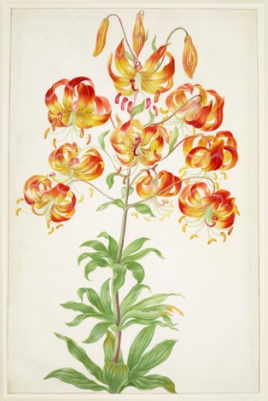
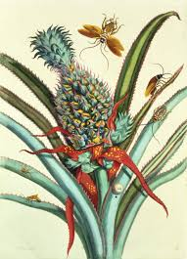
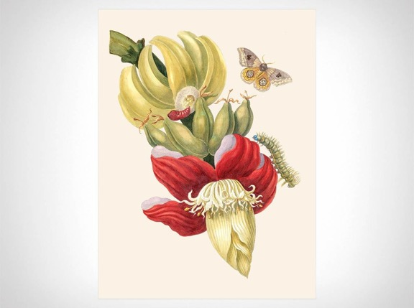
People wanted exotic floral paintings, it was a popular genre
Painters needed references of flowers and plant life because they rarely painted from nature
They normally painted from preserved specimens & exotic plants were hard to access
They relied on these women’s floral studies & botanical illustrations
Notes:
This is a more on WHY for the drive for botanical illustrations, explanation of importance at this time

Slide 5
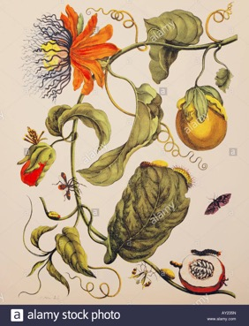
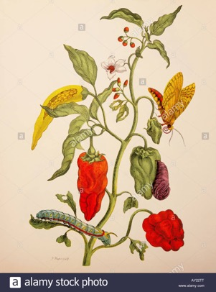
Maria Sybilla Merian
(1647-1717)
Transformed the field of scientific illustration
was well-respected in the male dominant scientific community
created large catalogues & volumes of illustrated plant & insect life
What made her different & progressive:
She drew directly from nature (plant species & insects)
Showed independence- traveled to South America to get these species, with no male companion.
Studied, collected, & illustrated plants & insects for 2 years abroad.
Notes:
Focus on one chosen artists from this time. One example of a women artist stepping above the norm and creating work opportunities for herself...

Slide 6
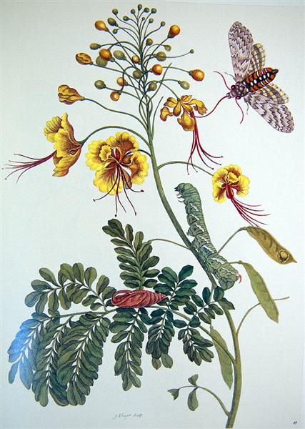
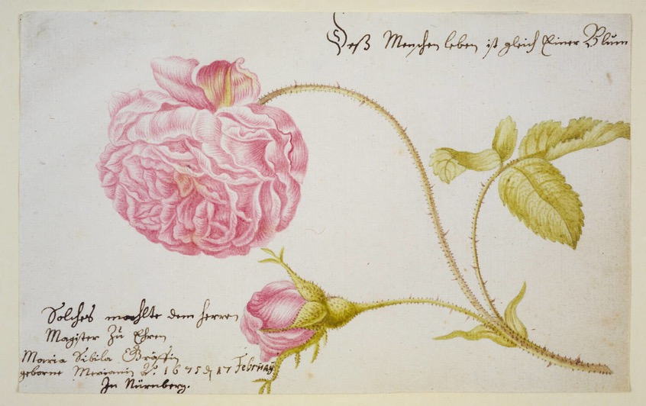
Notes:
More examples of Maria’s work

Slide 7
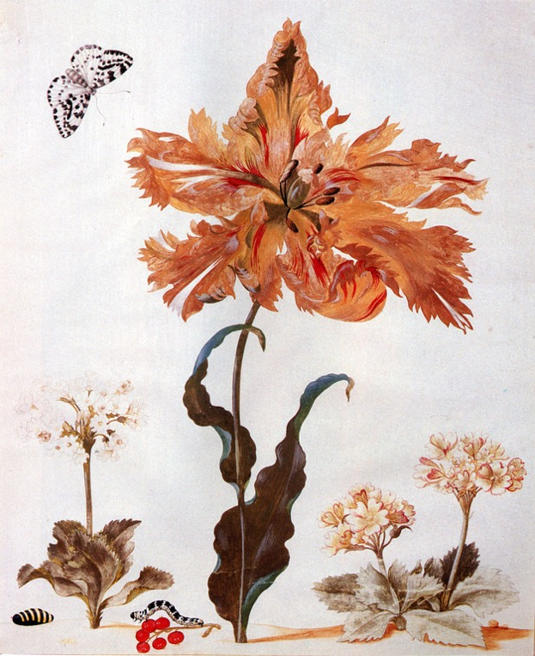
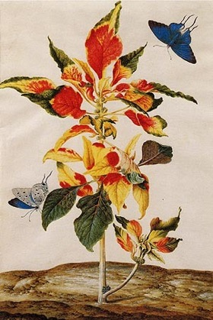
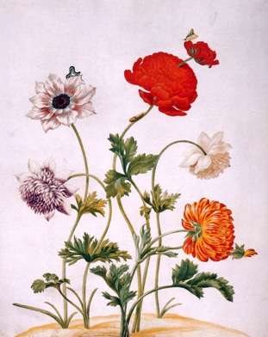
Thanks
Maria!!
Notes:
Bam
List of other artists that paint flowers from different places and times for further curiosities...whatever, got rid of- unless anyone else wants to add it

Slide 8
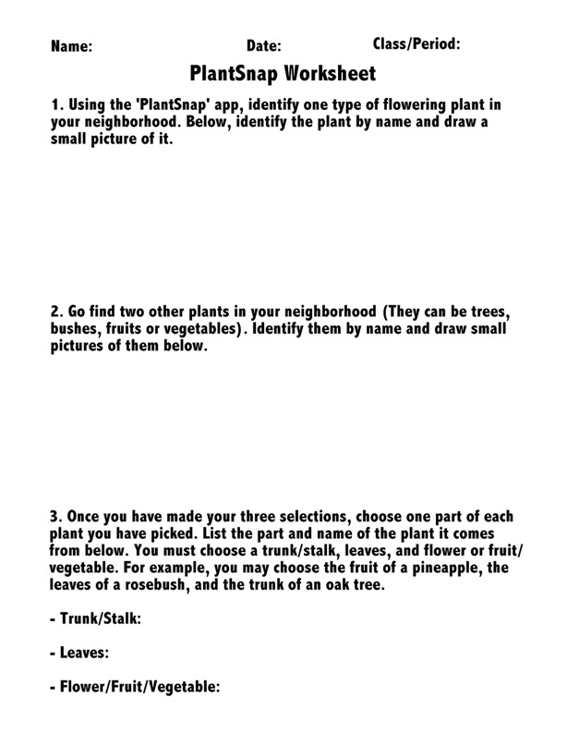
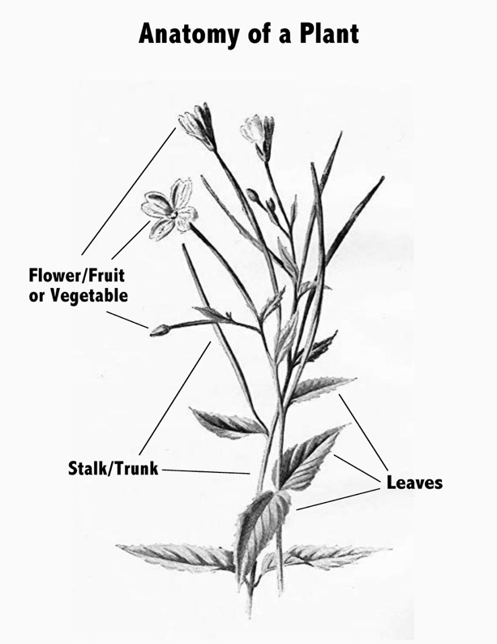
Notes:
Plant worksheet & plant diagram- student handout

Slide 9
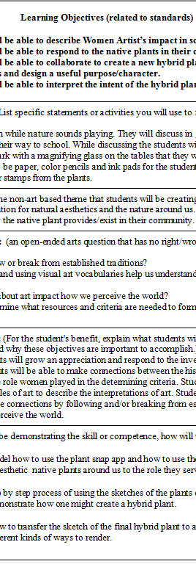
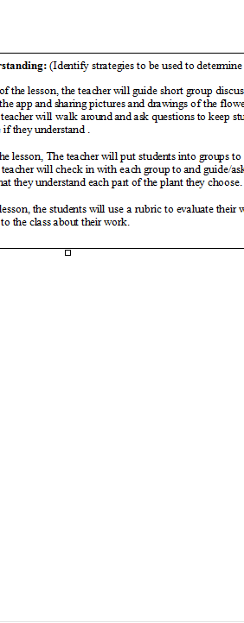
Notes:
Teacher Lesson Plan

Slide 10
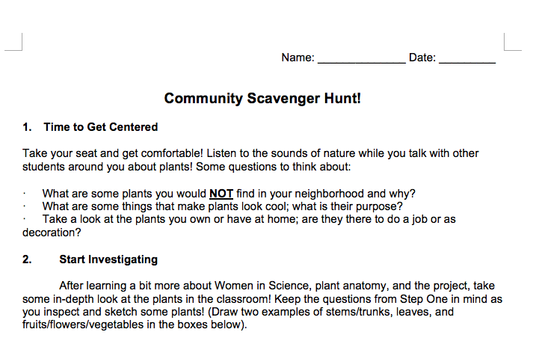
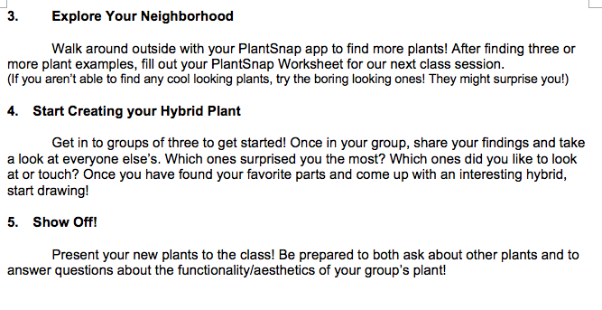
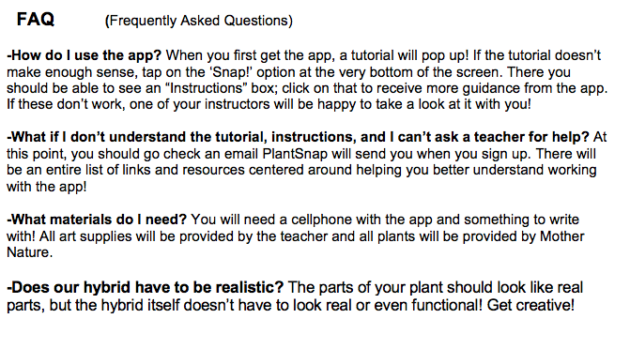
Notes:
Step by step

Slide 11
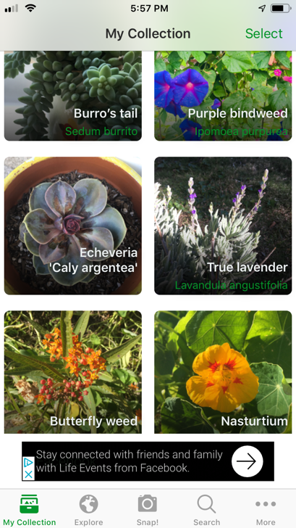
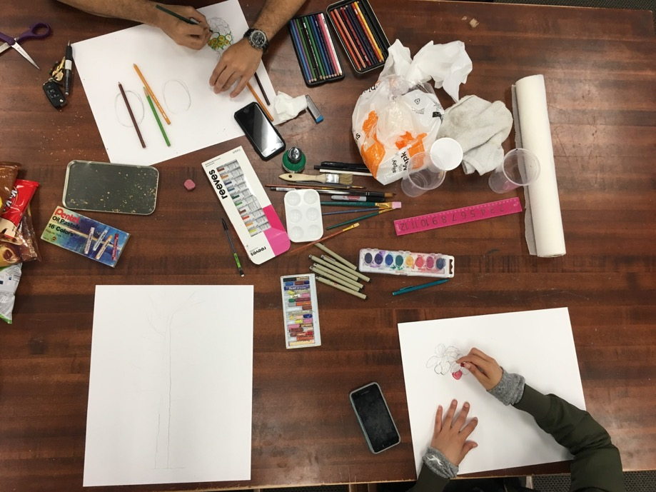
PlantSnap
Group Work! Work it Group!
Notes:
Photo of us all & the photo of app

Slide 12
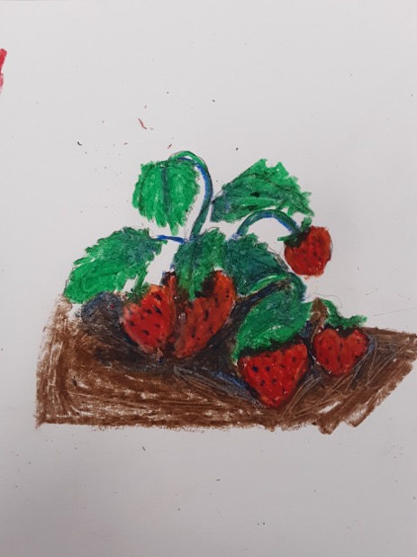
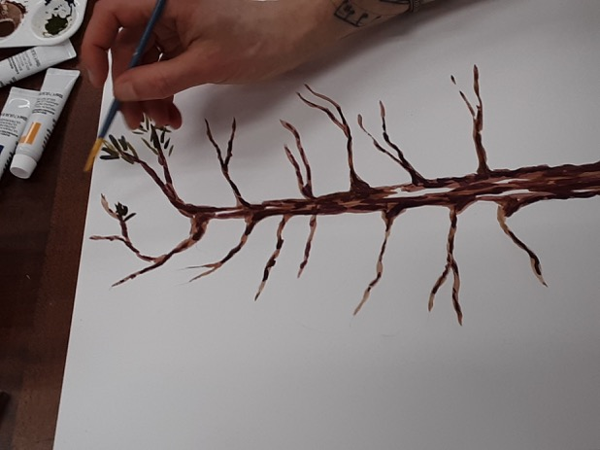
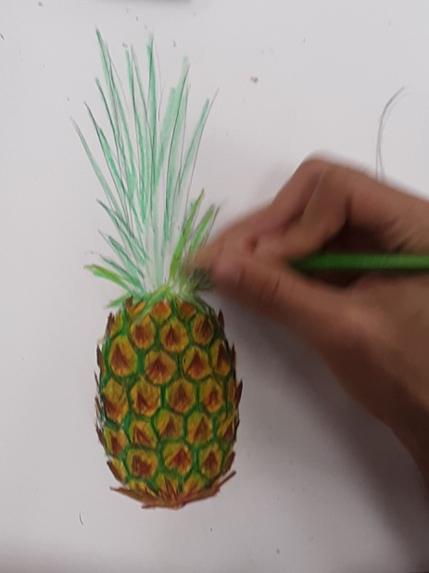
Everyone’s working so hard!

Slide 13
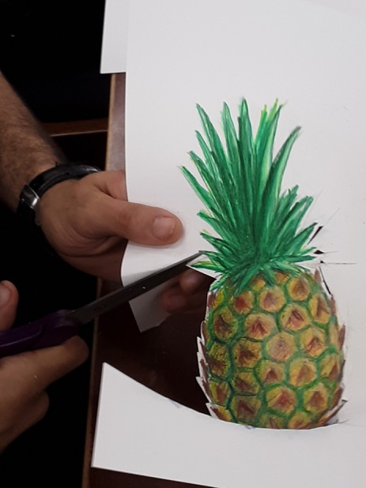
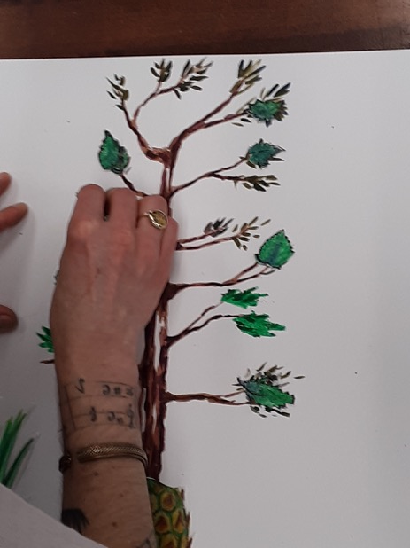
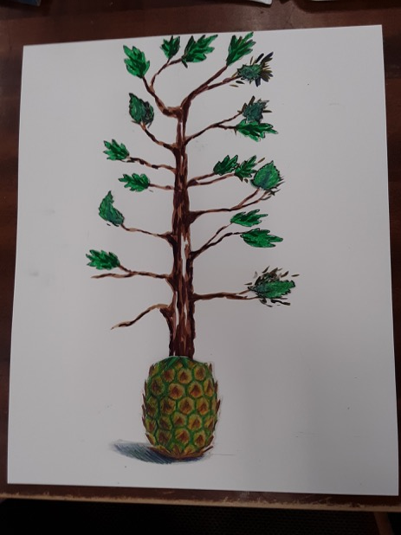
Getting all the pieces together!
Notes:
Show our process with the photos...I will bring our group’s finished piece!

Slide 14
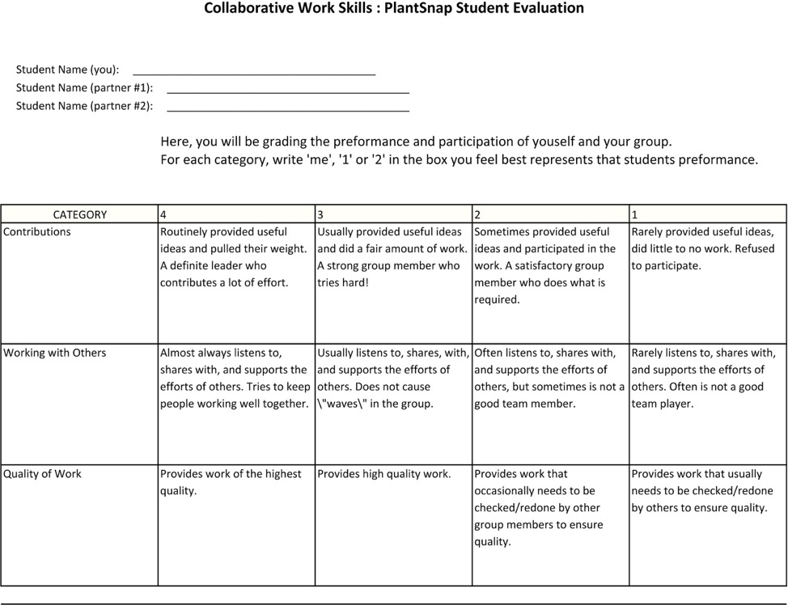
The
Group Peer Evaluation
Notes:
The student group rubric

Slide 15
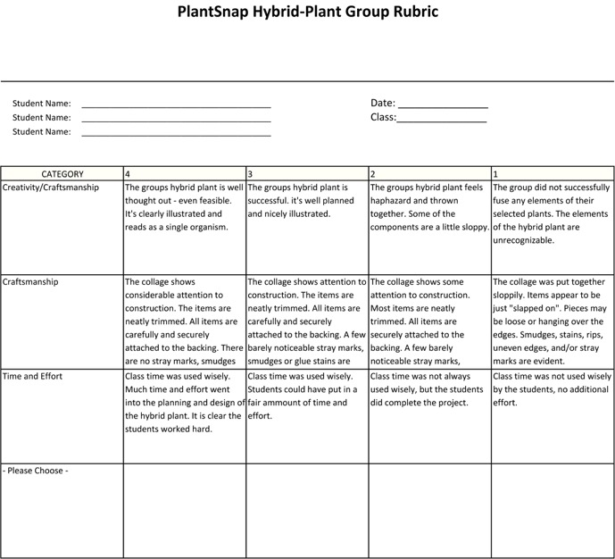
The Teacher’s Rubric
Notes:
Teacher rubric

Slide 16
The People Behind Pansies
The Fabulous Flower Fascination Foundation presents:
Women’s role in the history of floral art
17th Century- The Dutch:
IN EUROPE---AT THIS TIME……
Artistic subject matter was formed by societal pressure for women to only portray what was seen as feminine
& if they didn’t- it would be seen as unladylike and scandalous.
So- women artists used what card they were dealt and empowered themselves
Many male artists did not paint flowers because it was seen as unmanly- it was meant for the delicate hand of a female to create such delicate work
Notes:
Here- introducing the WHERE & TIME period---and what was going on during this time period...a light discussion. RELATABLE & age appropriate...relatable---being excluded

Slide 17
Holland -----------where science met art
The Dutch were Europe’s leading horticulturists at this time.
Increased interest in botanical and zoological knowledge due to :
Exploration- explorers were bringing home species from other lands
The invention of the microscope was in Holland
Notes:
More emphasis on WHERE--to give more perspective….on technology abilities gave reasons for such illustrations to even happen other than flowers are pretty
Antonie van Leeuwenhoek- single lense microscope

Slide 18
People wanted exotic floral paintings, it was a popular genre
Painters needed references of flowers and plant life because they rarely painted from nature
They normally painted from preserved specimens & exotic plants were hard to access
They relied on these women’s floral studies & botanical illustrations
Notes:
This is a more on WHY for the drive for botanical illustrations, explanation of importance at this time

Slide 19
Maria Sybilla Merian
(1647-1717)
Transformed the field of scientific illustration
was well-respected in the male dominant scientific community
created large catalogues & volumes of illustrated plant & insect life
What made her different & progressive:
She drew directly from nature (plant species & insects)
Showed independence- traveled to South America to get these species, with no male companion.
Studied, collected, & illustrated plants & insects for 2 years abroad.
Notes:
Focus on one chosen artists from this time. One example of a women artist stepping above the norm and creating work opportunities for herself...

Slide 20
Notes:
More examples of Maria’s work

Slide 21
Thanks
Maria!!
Notes:
Bam
List of other artists that paint flowers from different places and times for further curiosities...whatever, got rid of- unless anyone else wants to add it

Slide 22
Notes:
Plant worksheet & plant diagram- student handout

Slide 23
Notes:
Teacher Lesson Plan

Slide 24
Notes:
Step by step

Slide 25
PlantSnap
Group Work! Work it Group!
Notes:
Photo of us all & the photo of app

Slide 26
Everyone’s working so hard!

Slide 27
Getting all the pieces together!
Notes:
Show our process with the photos...I will bring our group’s finished piece!

Slide 28
The
Group Peer Evaluation
Notes:
The student group rubric

Slide 29
The Teacher’s Rubric
Notes:
Teacher rubric

